Slide 1
Agenda for GEOG260/360 GIS & Land Change Models
Today
Assignment 1 Grades
Post your questions to Discussions on Canvas
Discuss Assignment 2
Discuss Philosophies of Modeling
September 20
Submit Assignment 2 by 4pm on Canvas
Get instructions for Assignment 3
September 25
Discuss Assignment 3
September 27
Submit Assignment 3 by 4pm on Canvas
Get instructions for Assignment 3

Slide 3
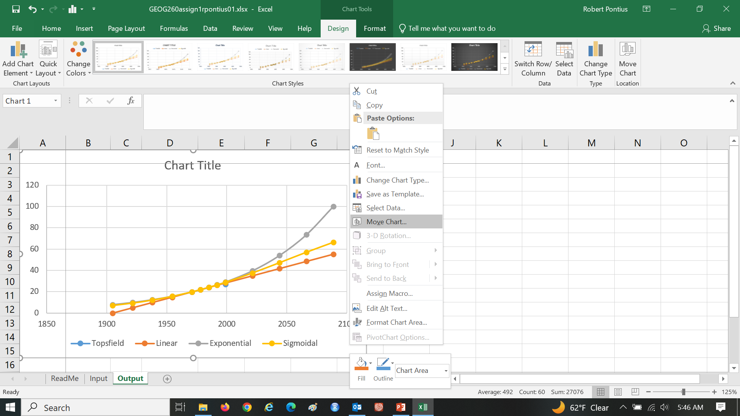
Assignment 1 Right click on Chart Area to Move Chart to a new sheet

Slide 4
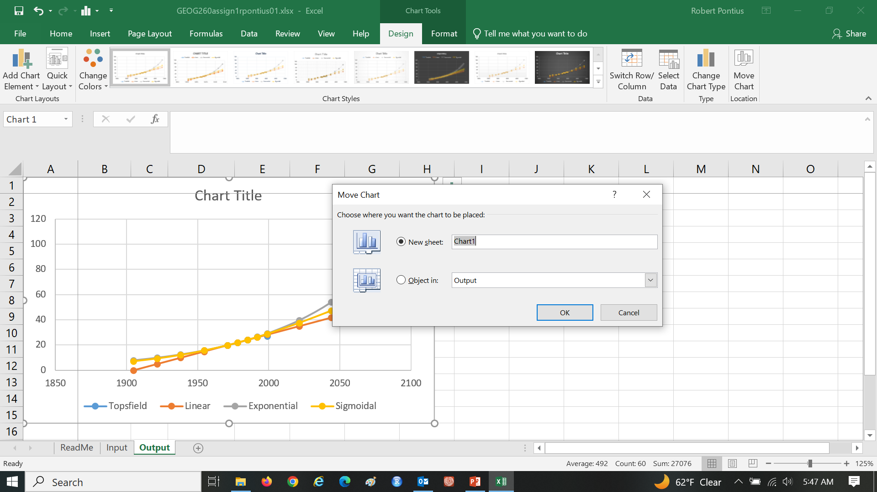
Assignment 1 Right click on Chart Area to Move Chart to a new sheet

Slide 5
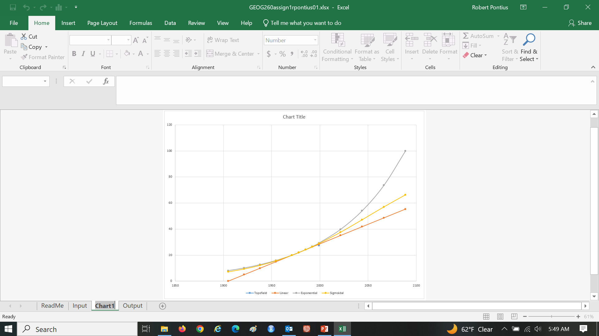
Assignment 1 Change Sheet name from Chart1 to Figure and move it to the far right

Slide 6

Post your questions to Have Discussions on Canvas

Slide 7
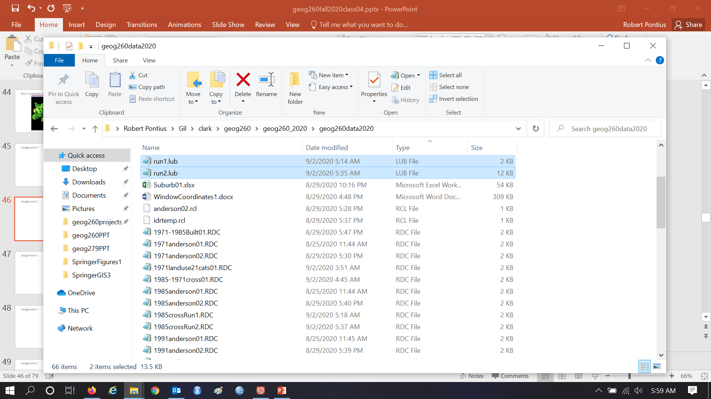
Each run produces a LUB and GMD text file.

Slide 8
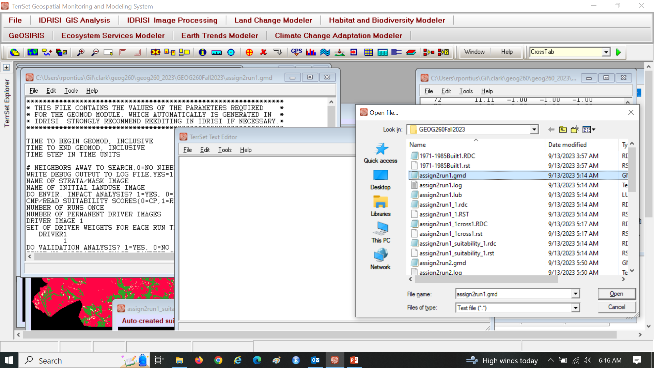
Use Notepad to see *.GMD, which is a text file

Slide 9
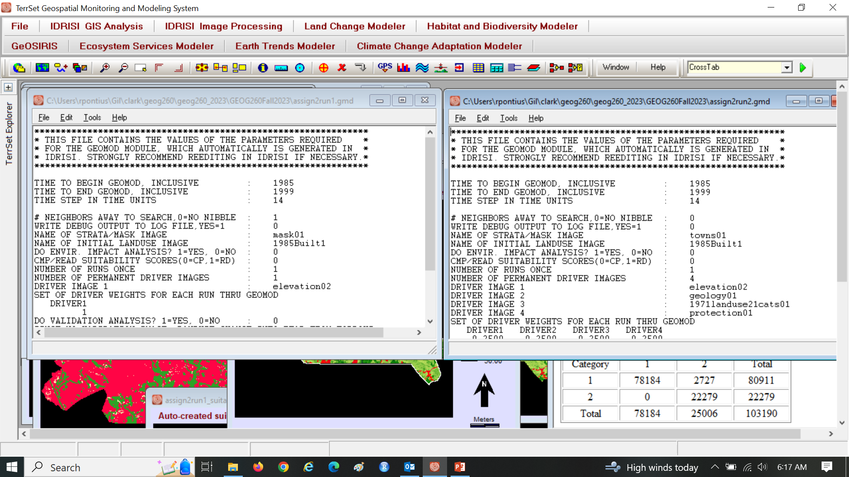
Compare assign2run1.gmd to assign2run2.gmd

Slide 10
Assignment 2 Grading Rubric
1. Submit two slides that describe run 1 according to the bullets below. 35 points
Include the name(s) of student(s) 5 points
Include an Elevation map with a caption. 5 points
Include a CROSSTAB map that shows simulated change with a caption. 15 points
Include a paragraph that explains where the largest suitability values are in run1 map. The high suitability values occur at elevations between 20-30, with elevation 25 being the highest. As a result, one can conclude that builders tend to develop more intensively these elevations.
Include a paragraph that describe how Geomod computed the suitability values. 5 points Geomod computes the suitability for each pixel by first comparing the driver map(elevation) to the 1985 binary map, and for each category (1 meter each) of the elevation map a percent is calculated from the ratio of the quantity of built to the total quantity of pixels within each category. These percentages (the suitability values) are then used to reclassify the map into a suitability map. The maximum suitability value was 28.57 but we set the display to 50 to better show the difference between Run 1 and Run 2.
2. Submit two slides that describe run 2 according to the bullets below. 45 points
Include a group of four driver maps with a caption. 15 Points
Include a CROSSTAB map of simulated change with a caption. 20 points
Include a paragraph that explain where the largest suitability values in run2 map. 5 points
Include a paragraph that describe how Geomod computed the suitability values. 5 point
3. Submit one slide that describes GEOMOD’s simulation behavior and assessment of validation. 15points
4. Bonus. 5 points

Slide 11
Assignment 2
Use data in ForestOtherBuilt2.zip from Canvas, which is the same data as for Assignment 1. Perform two runs of Geomod. For both runs, use 1985Built1 at 1985 as Beginning landuse image, 1985 as Beginning time, 1999 as ending time, 14 as time step, and do not do environmental impact analysis.
For first run, create parameter file called run1, use Mask, Neighborhood search mode constrained by width 3 by 3, 1 simulation, 1 driver with equal weights, Driver map as elevation02, use an extrapolation of the gross built gain during 1971-1985 to determine the simulated quantity at 1999, do not output interim time images, use run1 as prefix.
For second run, create parameter file called run2, use towns map as Strata, Neighborhood search mode unconstrained, 1 simulation, 4 drivers with equal weights, Driver maps as elevation02, geology, 1971 landuse 21 categories, protection, use 1999Built1 at 1999 as ending time landuse validation image to determine the quantity by town, do not output interim time images, use run2 as prefix.
For each model run, perform CROSSTAB to produce a map that shows the simulated changes from 1985. Submit one PPTX or PDF file that shows for each run the: driver map(s), Geomod’s suitability map, your CROSSTAB map that shows simulated changes. Include paragraphs that describe how Geomod computed the suitability values and explain where the largest suitability values are for each run. Also, describe the behavior of Geomod’s simulation and your assessment of validation.

Slide 12
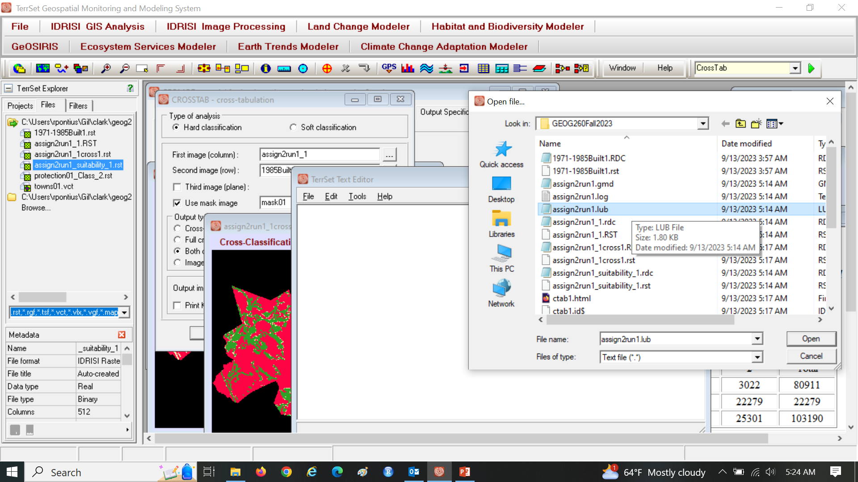
Open assign2run1_1.lub

Slide 13
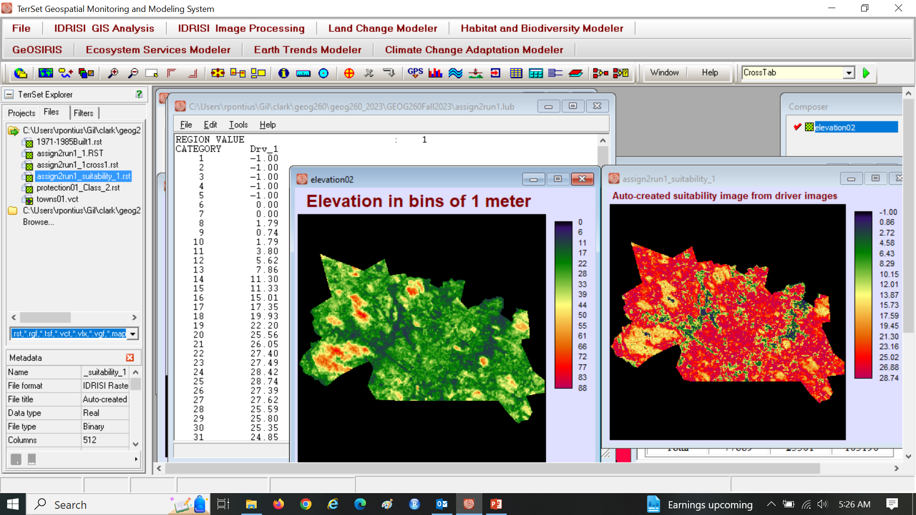
assign2run1_1.lub shows a ratio for each elevation bin

Slide 14
Each elevation receives a percentage that derives from an overlay of elevation with 1985 built

Slide 15
The percentage for each elevation bin = 100% * (size of 1985 built on the elevation bin)/(size of elevation bin)

Slide 16
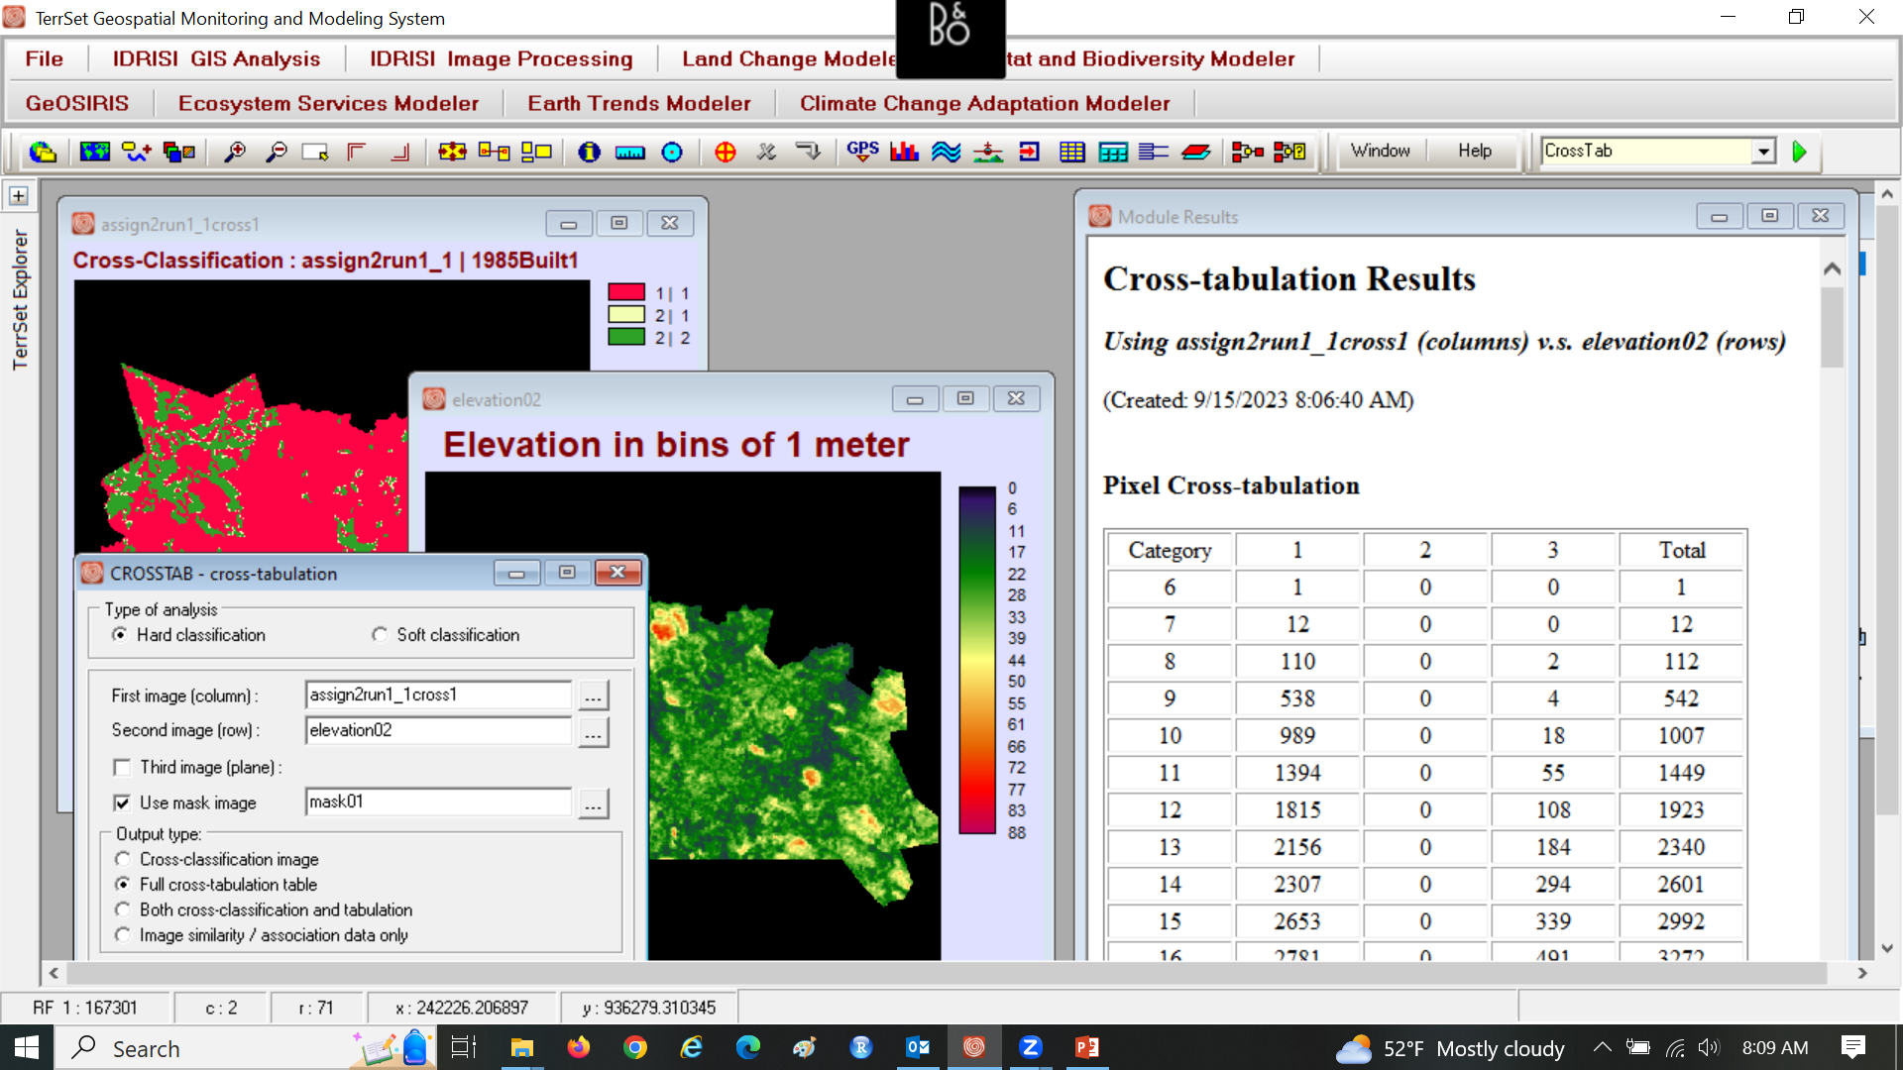
Use CROSSTAB to see the elevations where simulated change occurred?

Slide 17
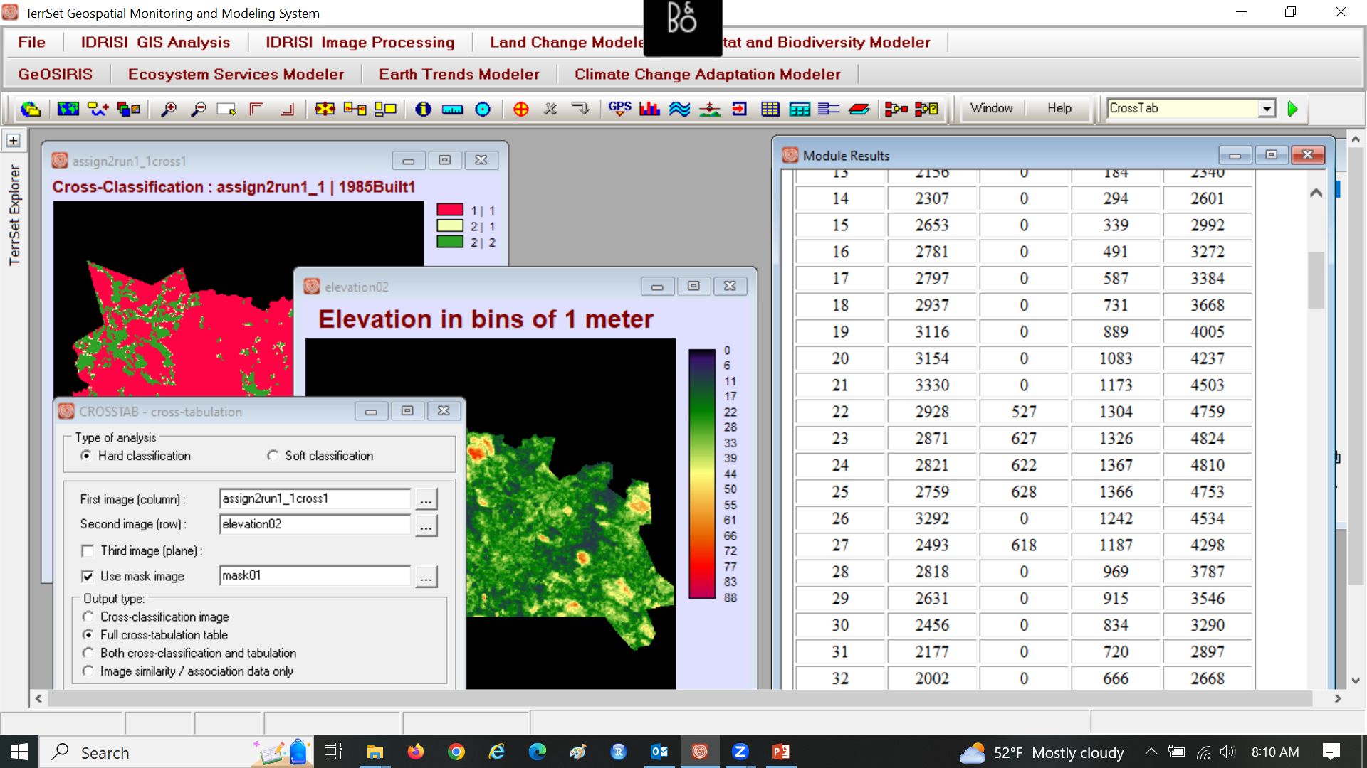
Run1 simulated change on elevations 22-25, 27. Why?

Slide 18
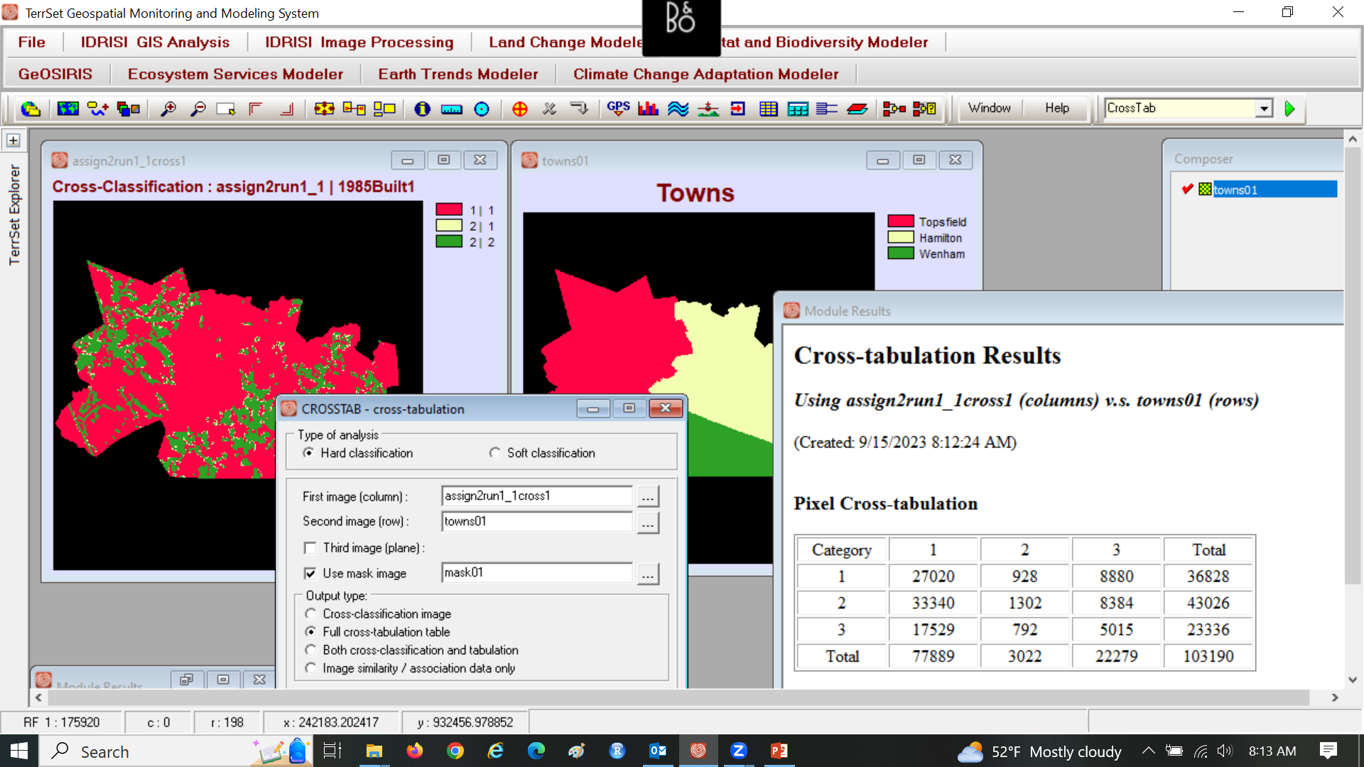
Run1 simulated how much change in each town? Why?

Slide 19
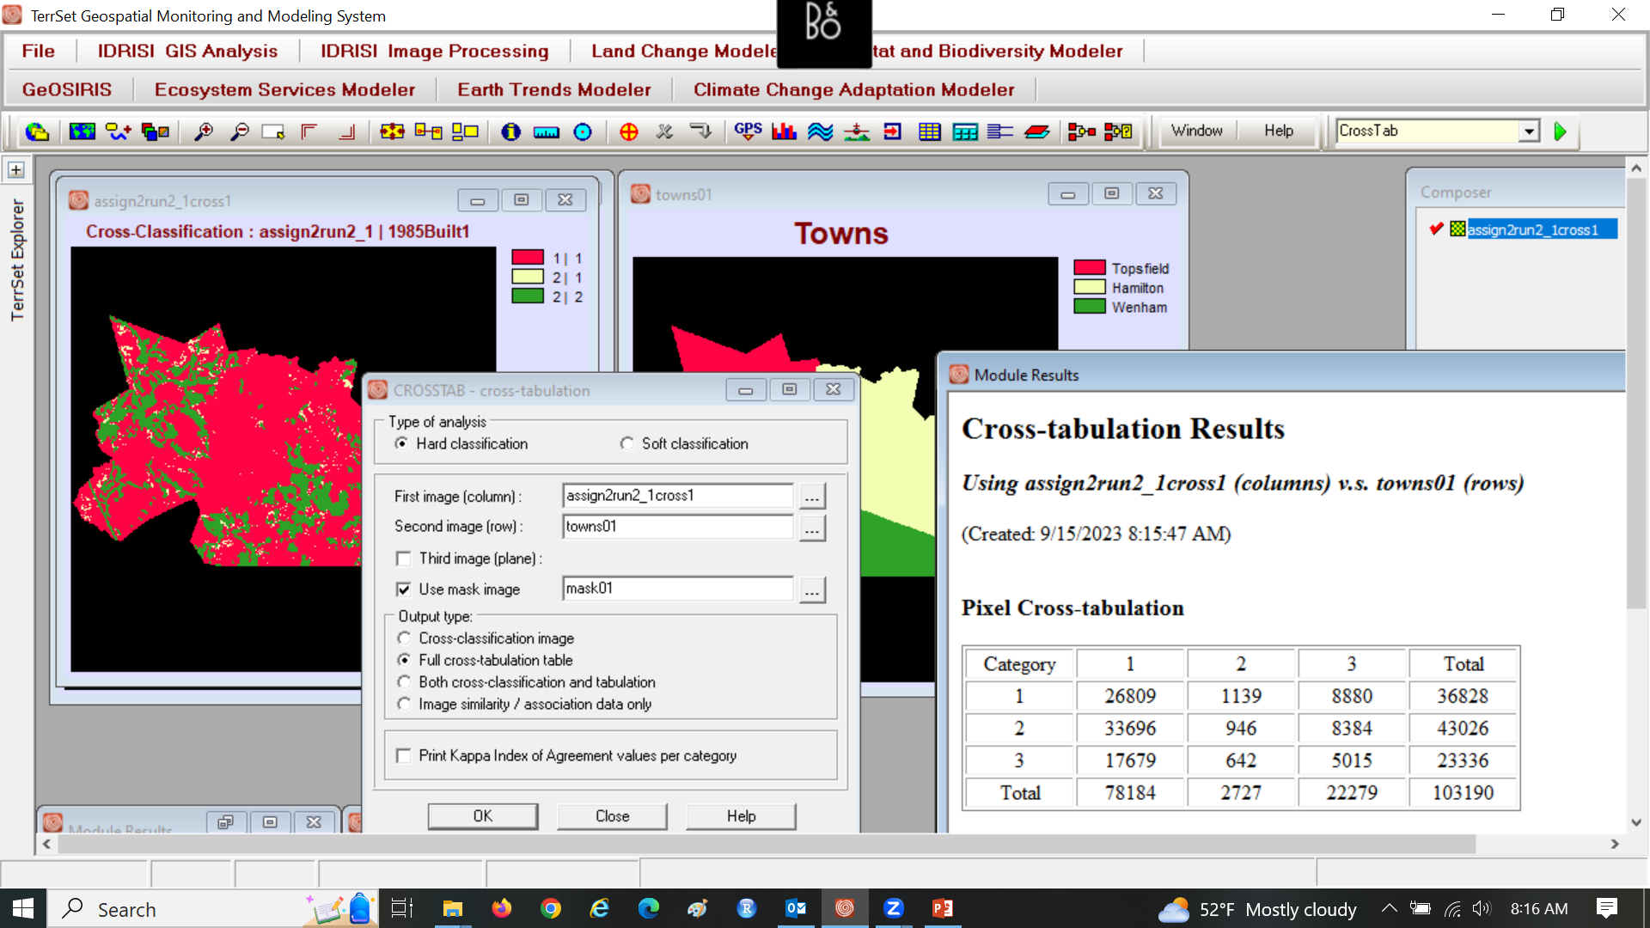
Run2 simulated how much change in each town? Why?

Slide 20
Run 1 Suitability is based on elevation02

Slide 21
Run 2 Suitability is based on 4 driver maps and towns

Slide 22
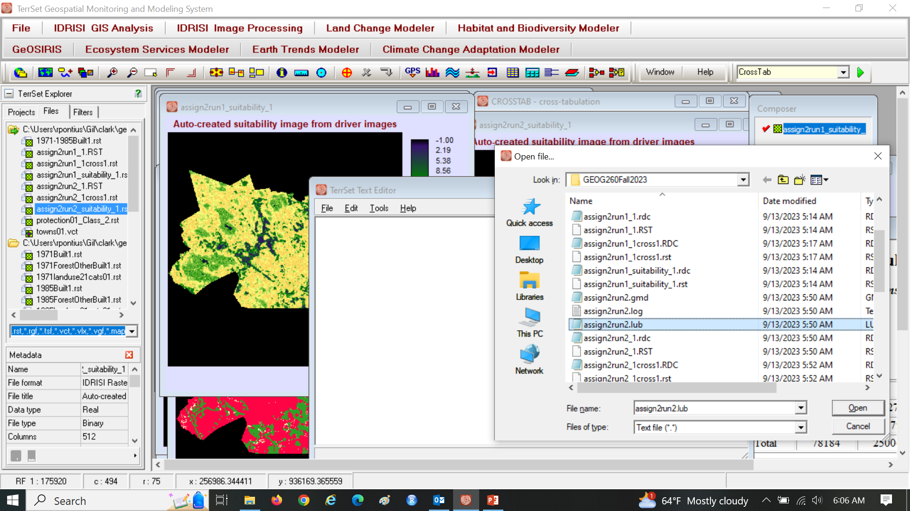
Use Notepad to see assign2run2.lub

Slide 23
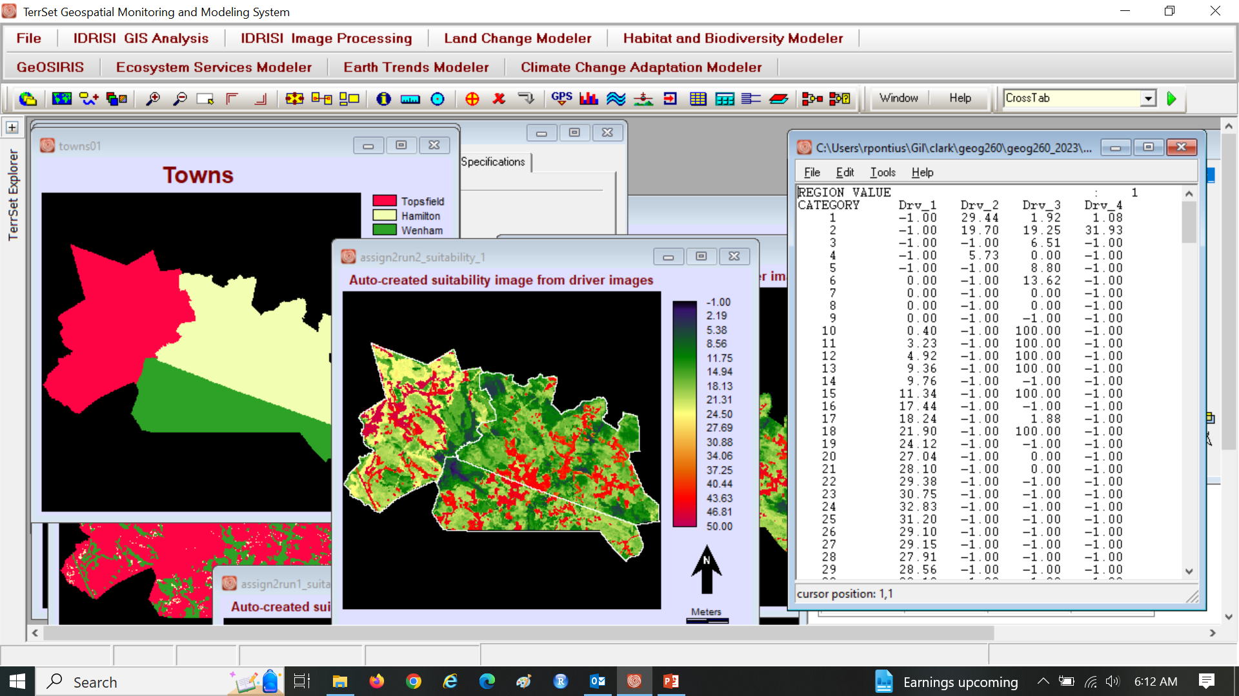
See values of each bin of each driver of each town

Slide 24
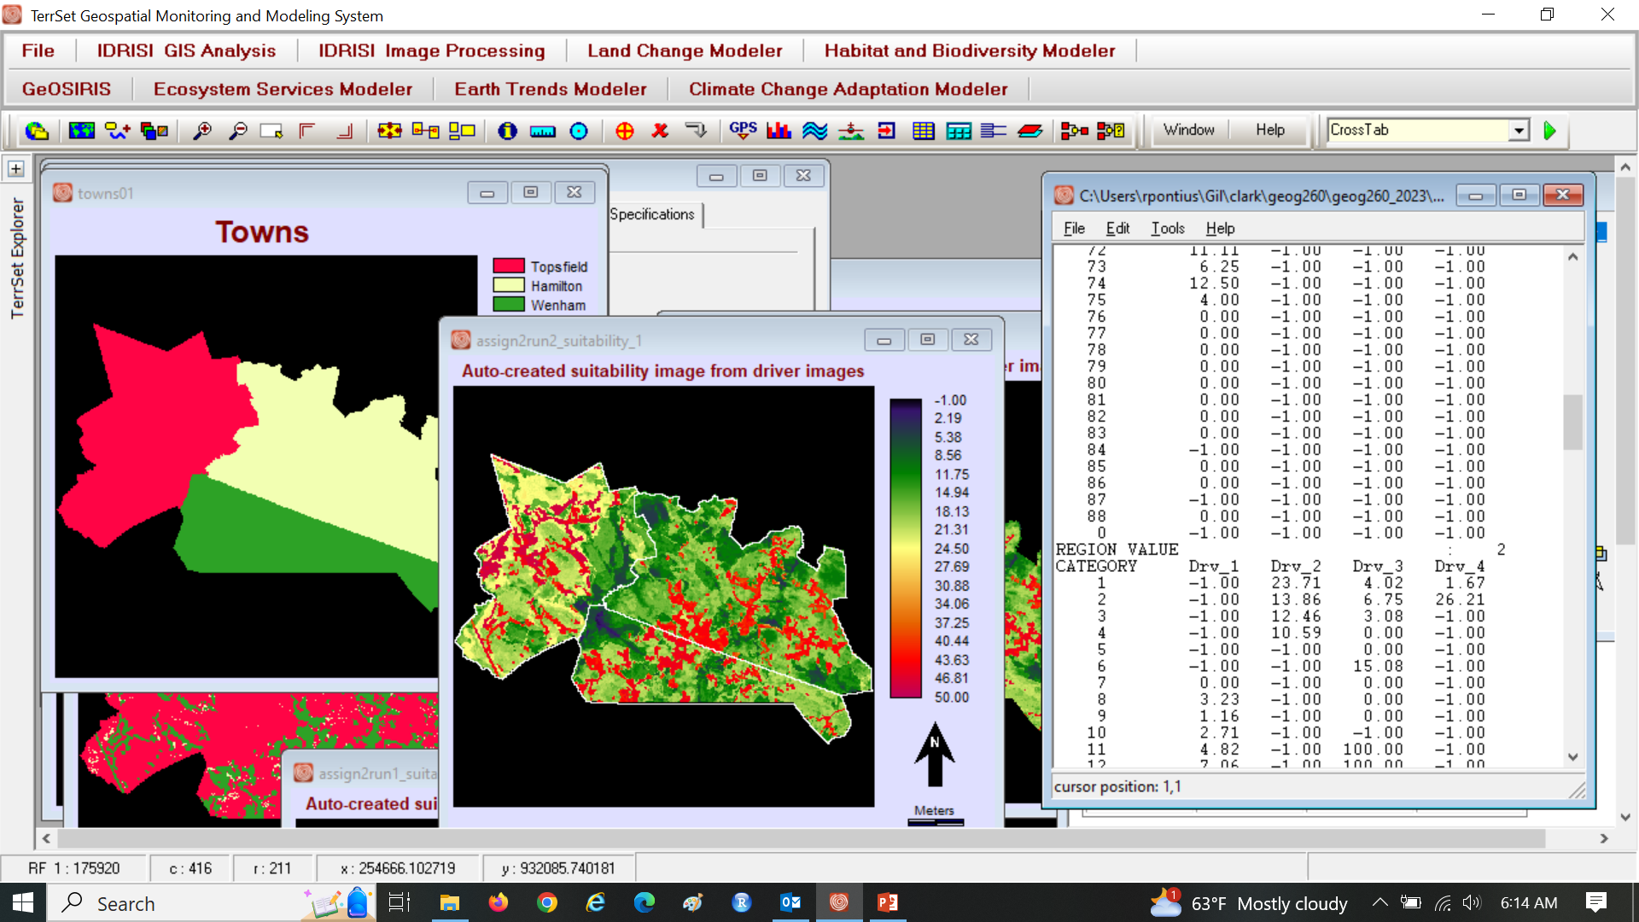
See values of each bin of each driver of each town

Slide 25
What explains the difference between Run 1 and Run 2?
Suitability
Simulated Gain of Built 1985-1999

Slide 26
Why does the quantity differ between runs? Why does the allocation differ between runs?
Suitability
Simulated Gain of Built 1985-1999

Slide 27
For Run 1 quantity, calibration time interval is 1971-1985, and validation time interval is 1985-1999.

Slide 28
How should we assess validation, given the following?
Run 1
The simulated quantity of built gain for run 1 derives from extrapolation of linear interpolation through 1971 and 1985.
The simulated allocation of built gain for run 1 derives calibration of a suitability map based on an overlay of built at 1985 and elevation.
Run 2
The simulated quantity of built gain for run 2 derives matching the actual size of built gain in the maps at 1985 and 1999 in each town.
The simulated allocation of built gain for run 2 derives calibration of a suitability map based on an overlay of built at 1985 and elevation, geology, 1971 land use, and protected status.

Slide 29
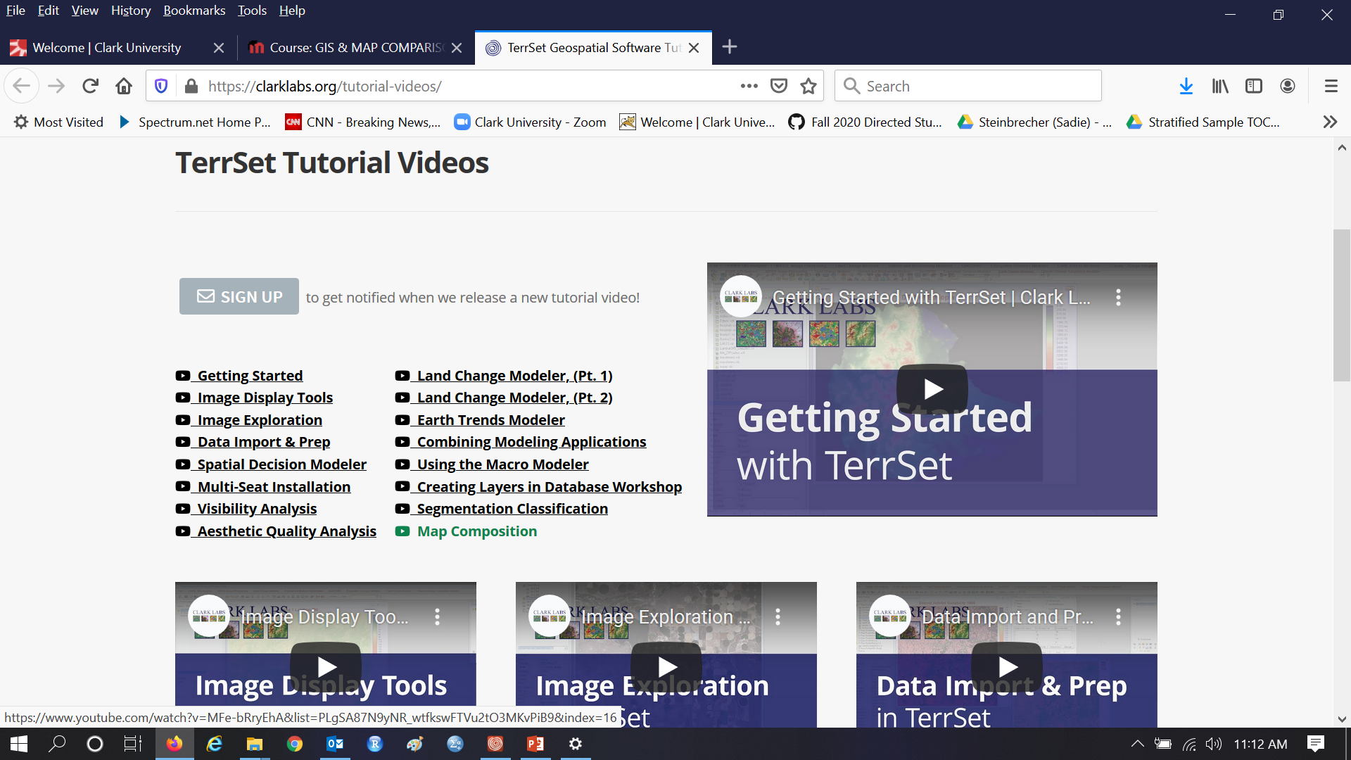
Watch Video concerning Map Composition

